Slide 1
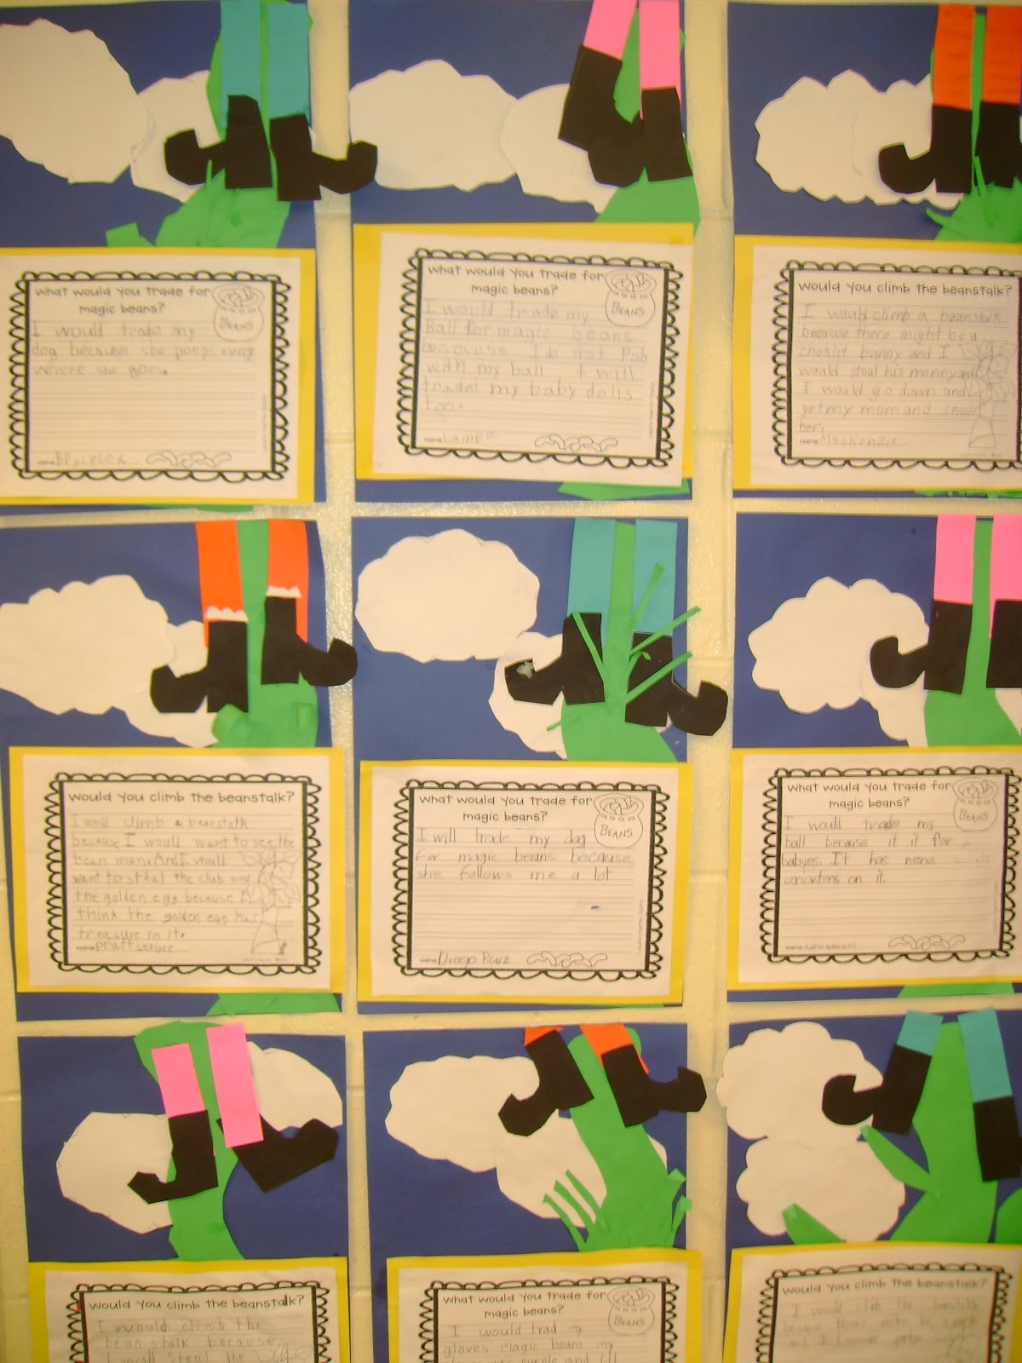
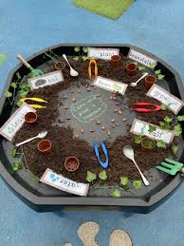
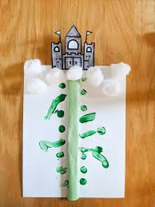
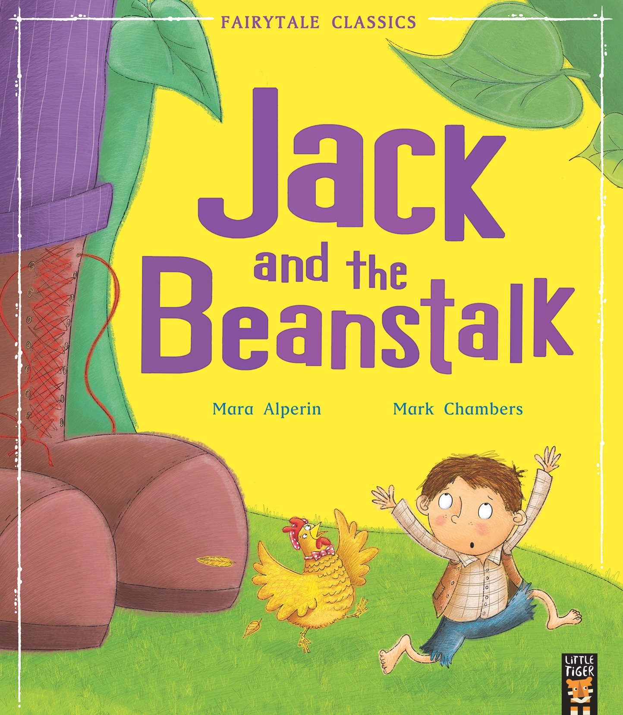
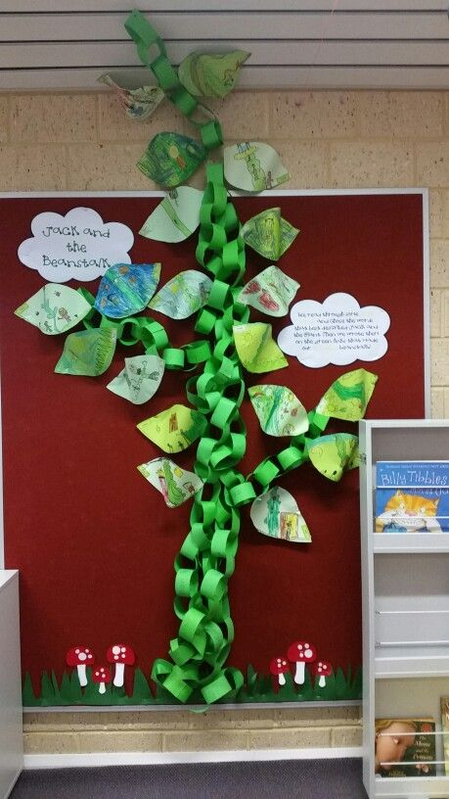
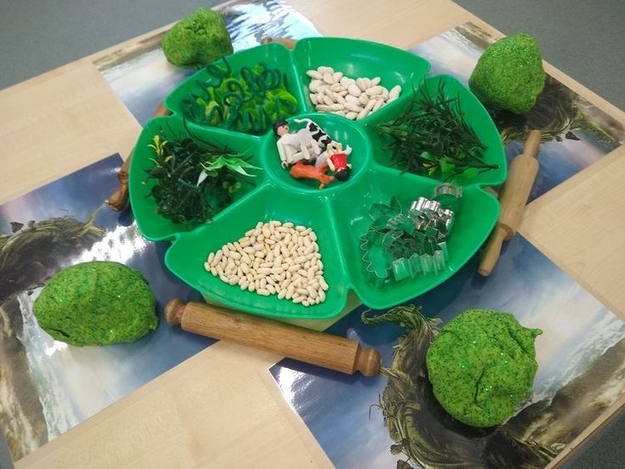
Writing Opportunities (Message Centre) Drawing Club
CVC Words AL
Story sequence
Mark making
Understanding the World
Growing plants
Children can grow their own beanstalk and watch how their seed changes.
The life cycle of a bean.
Sensory tuff tray
Communication and Language
Retell the story,
Library Visit
Encourage the children to explore the characters further and learn new vocabulary.
Personal social and emotional
Build constructive and respectful relationships. • Express their feelings and consider the feelings of others. • Manage their own needs. - Personal hygiene
• Show resilience and perseverance in the face of challenge
Circle time: Zones of regulation
Expressive Arts and design
Paint a large beanstalk
Explore the colour green by mixing different shades. Invite the children to paint their own leaf with their shade of green for a class beanstalk.
Provide instruments for children to create music and dances which reflect the characters from the story, such as banging a drum and stomping for the giant.
P.D fine motor skills
Threading
Cutting Skills
Painting
Gardening
Colouring
Duplo
Playdoh
Jack and the Beanstalk tracing cards
Physical Development (
Dancing
Balance and coordination
Create a Jack and the Beanstalk themed movement game. Can the children grow slowly like a beanstalk, stomp like a giant and climb down the beanstalk quickly, like Jack
Maths
Provide a range of shapes for children to create castles with. Can they tell you the shapes used to make their castle
Counting actions 1-5- 1-10
Actions songs
Subsidizing up to 5

