Slide 1





Riverside Parents Information Meeting
Pear
pearclass@riversideprimaryschool.org.uk
Poplar
pearclass@riversideprimaryschool.org.uk

Slide 2
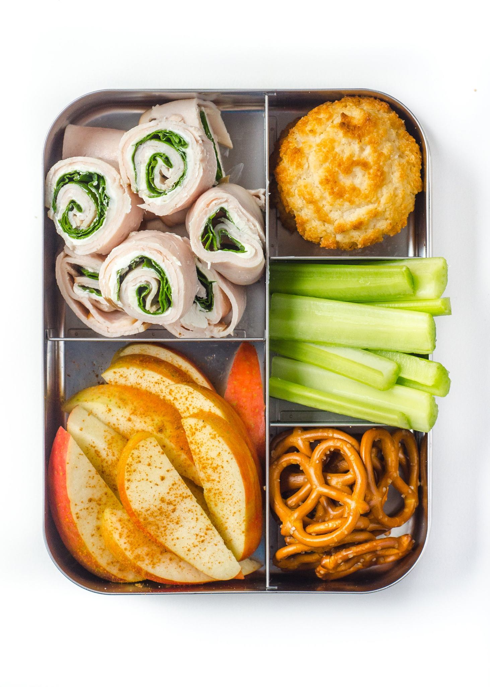
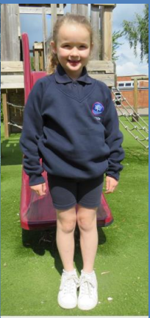
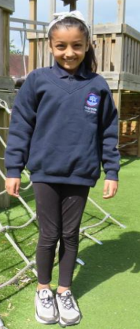

Uniform and Lunchboxes
Sandwich
Fruit
Vegetables
Yoghurts
Rice
Pasta
NO NUTS
NO CHOCOLATE
NO FIZZY DRINKS
Snacks
Eaten in class
Fruit or vegetables only
Notes:
GIRLS:
Navy cardigan with school logo*
White shirt
Navy/red tie*
Grey skirt or trousers
Plain black shoes (no heels)
Summer dress
If headscarf is worn then it must be white
BOYS:
Navy jumper with school logo*
White shirt
Navy/red tie*
Grey trousers/shorts
Plain black shoes (no trainers)

Slide 3
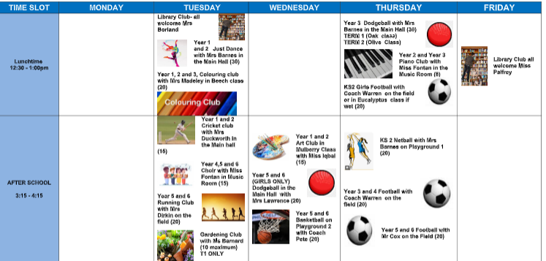
P.E and clubs
Outdoor P.E
Tuesday
Indoor P.E
Wednesday
Club timetable

Slide 4
Autumn 1 Curriculum Overview
Maths Place Value Number - Addition and Subtraction | English Rose Blanche Diary of Anne Frank Boy in the Striped Pyjamas | History How have children’s lives changed | P.E. GYMNASTICS - Unit P Balance ATHLETICS (Val Sabin) | RE Are all religions equal?
Science Digestion and Food | Computing Coding:Scratch Online Safety 1 Art Drawing:power prints | French Birthdays. Days dates and seasons | PSHE Families and Relationship | Music Body and tuned percussion - Rainforest

Slide 5
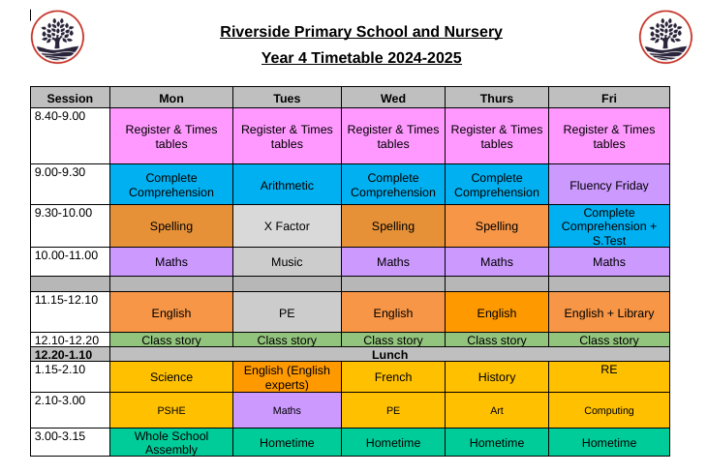
Weekly Timetable
Snip class timetable

Slide 6





Home learning
20 minutes reading & sign reading record daily
Review after each book
Ready Steady Spell Weekly practice
Test: Friday
Support booklet
4 x per week TTRockstars and Numbots
Online
1 lesson set by teacher per week
Online

Slide 7
MTC
The MTC (multiplication tables check) is a statutory government test designed to determine whether pupils can recall their times tables fluently.
This is essential for future success in mathematics.
It will help schools to identify pupils who have not yet mastered their times tables, so that additional support can be provided.
The test consists of multiplication questions and the children will have a set time to answer each question.
There are 25 questions and children will have 6 seconds to answer each.

Slide 8
MTC
Last year Riverside did incredibly well. We were above the national average with the mean score and we were also well above the national average for children getting full marks. This year we want to do even better!
 | National data | Riverside data
Average score | 20.2 | 22.2
Full marks | 29% | 54%

Slide 9

MTC

Slide 10


Parent Workshops
Spelling
RWI parent meeting
Maths
Date: Tues 1st Oct
Date: Wed 9th Oct
Date: Thurs 17th Oct

Slide 11

Friends of Riverside
2024/2025 events:
Christmas Fair: Weds 11th December
Eid Fair: Weds 2nd April
Summer Fair: Thurs 17th July
Our parent teacher community needs your help. We need help to organise and run fundraising events at Riverside to raise funds for the school OPAL project.
Children of parent helpers will benefit from free vouchers to use at the events.
To sign up to help, either let your class teacher know at the end of this session or email Miss Shepherd at :
friendsofriverside@riversideprimaryschool.org.uk

Slide 12
Trips
December | Theatre Royal Pantomime - around £20 per child . TBC ASAP
February | Gym and Dance show at Braywick. FREE. Parents can book tickets closer to the time.
April | St Luke’s church- Easter FREE
June | Local walk to the river- Geography. FREE

Slide 13



Class page

Slide 14

Any questions?

