Slide 1

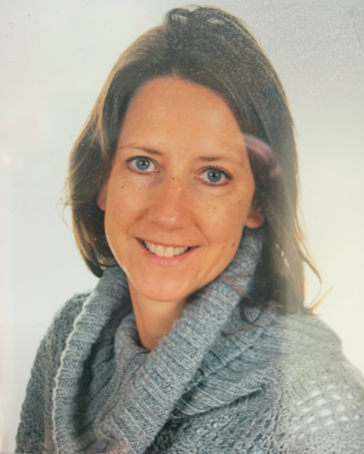
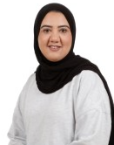
Riverside Parents Information Meeting
Cherry Class
cherryclass@riversideprimaryschool.org.uk
Mrs Black
Class Teacher
Mrs Iqbal
Teaching Assistant

Slide 2
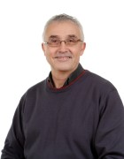
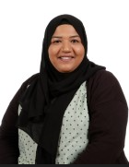
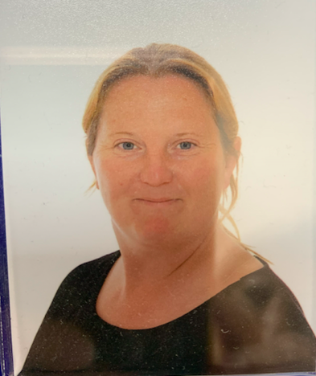
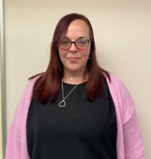
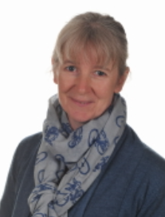
Riverside Parents Information Meeting
Chestnut Class
chestnutclass@riversideprimaryschool.org.uk
Mr Tillyer Mrs Asghar Miss Lawrence
Mrs Colton Mrs Kenneth

Slide 3
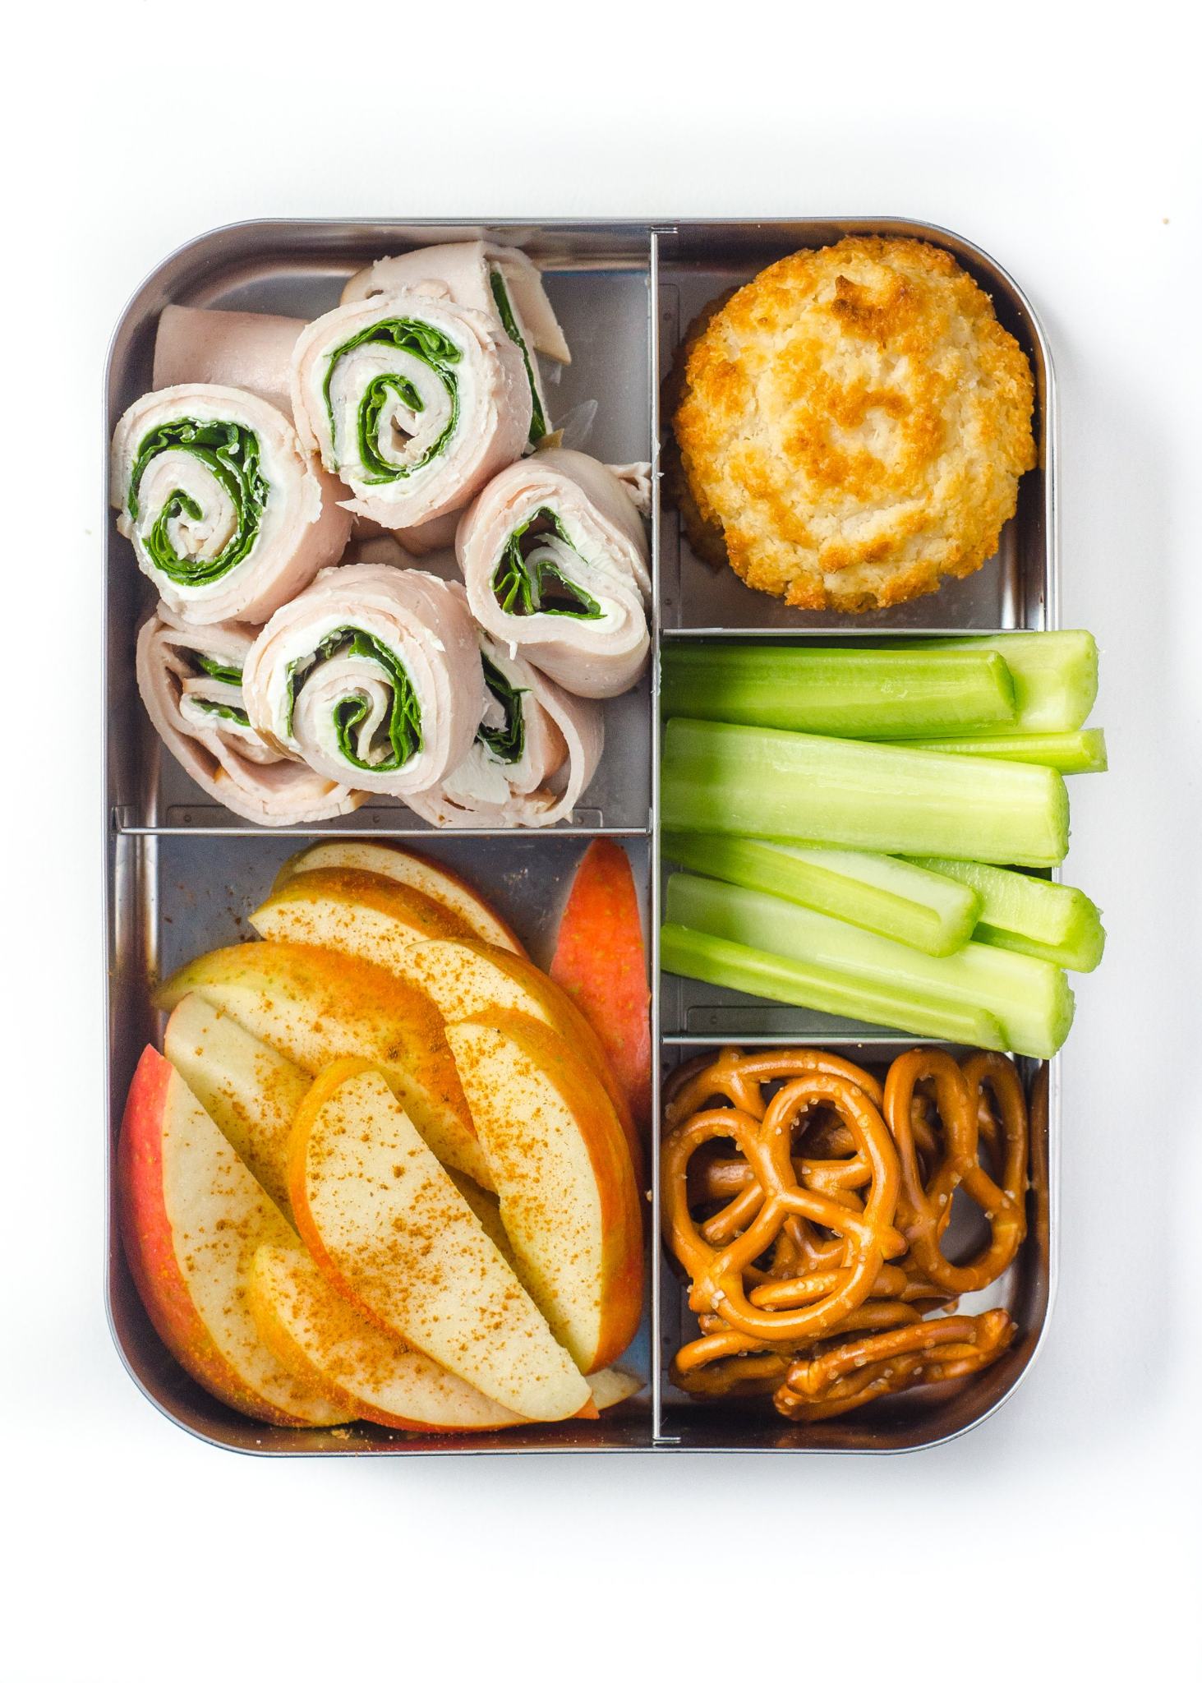
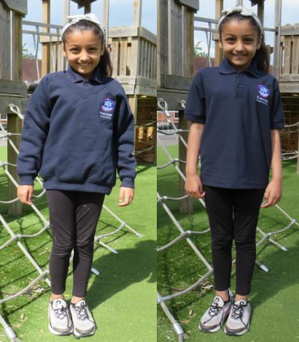
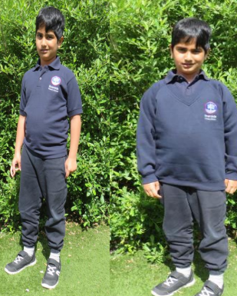

Uniform and Lunchboxes
Sandwich
Fruit
Vegetables
Yoghurts
Rice
Pasta
NO NUTS
NO CHOCOLATE
Snacks
Eaten in class
Fruit or vegetables only
Notes:
GIRLS:
Navy cardigan with school logo*
White shirt
Navy/red tie*
Grey skirt or trousers
Plain black shoes (no heels)
Summer dress
If headscarf is worn then it must be white
BOYS:
Navy jumper with school logo*
White shirt
Navy/red tie*
Grey trousers/shorts
Plain black shoes (no trainers)

Slide 4
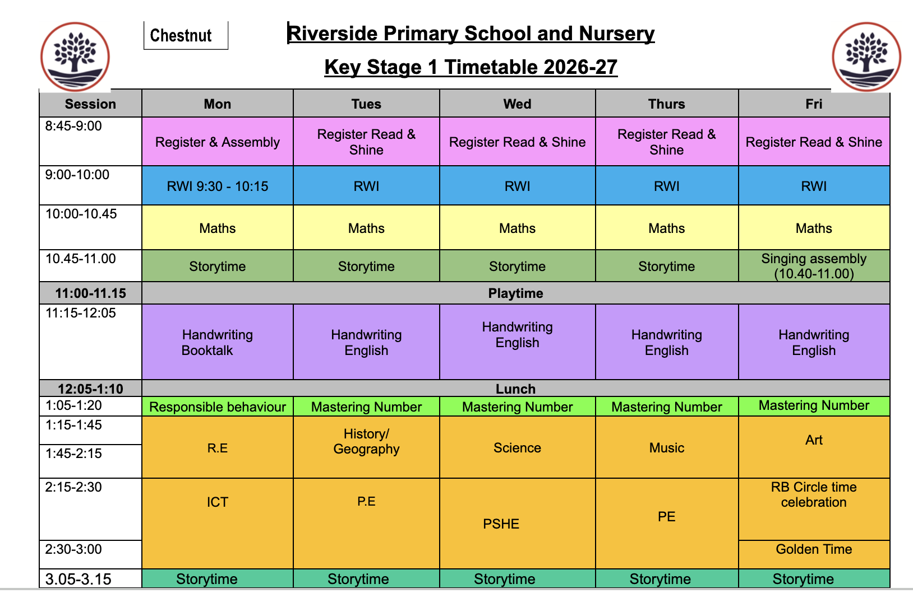
Weekly Timetable

Slide 5
Autumn 1 Curriculum Overview
Maths Place value to 10 Addition and Subtraction | English There is a Tiger in the Garden The Something | History How am I making history? | P.E. Gymnastics | RE Our Wonderful World
Science My Body | Art Art and Design skills | Computing Improving mouse skills | PSHE My Healthy Self: How can I look after myself and my emotions? | Music Pulse and rhythm - all about me

Slide 6
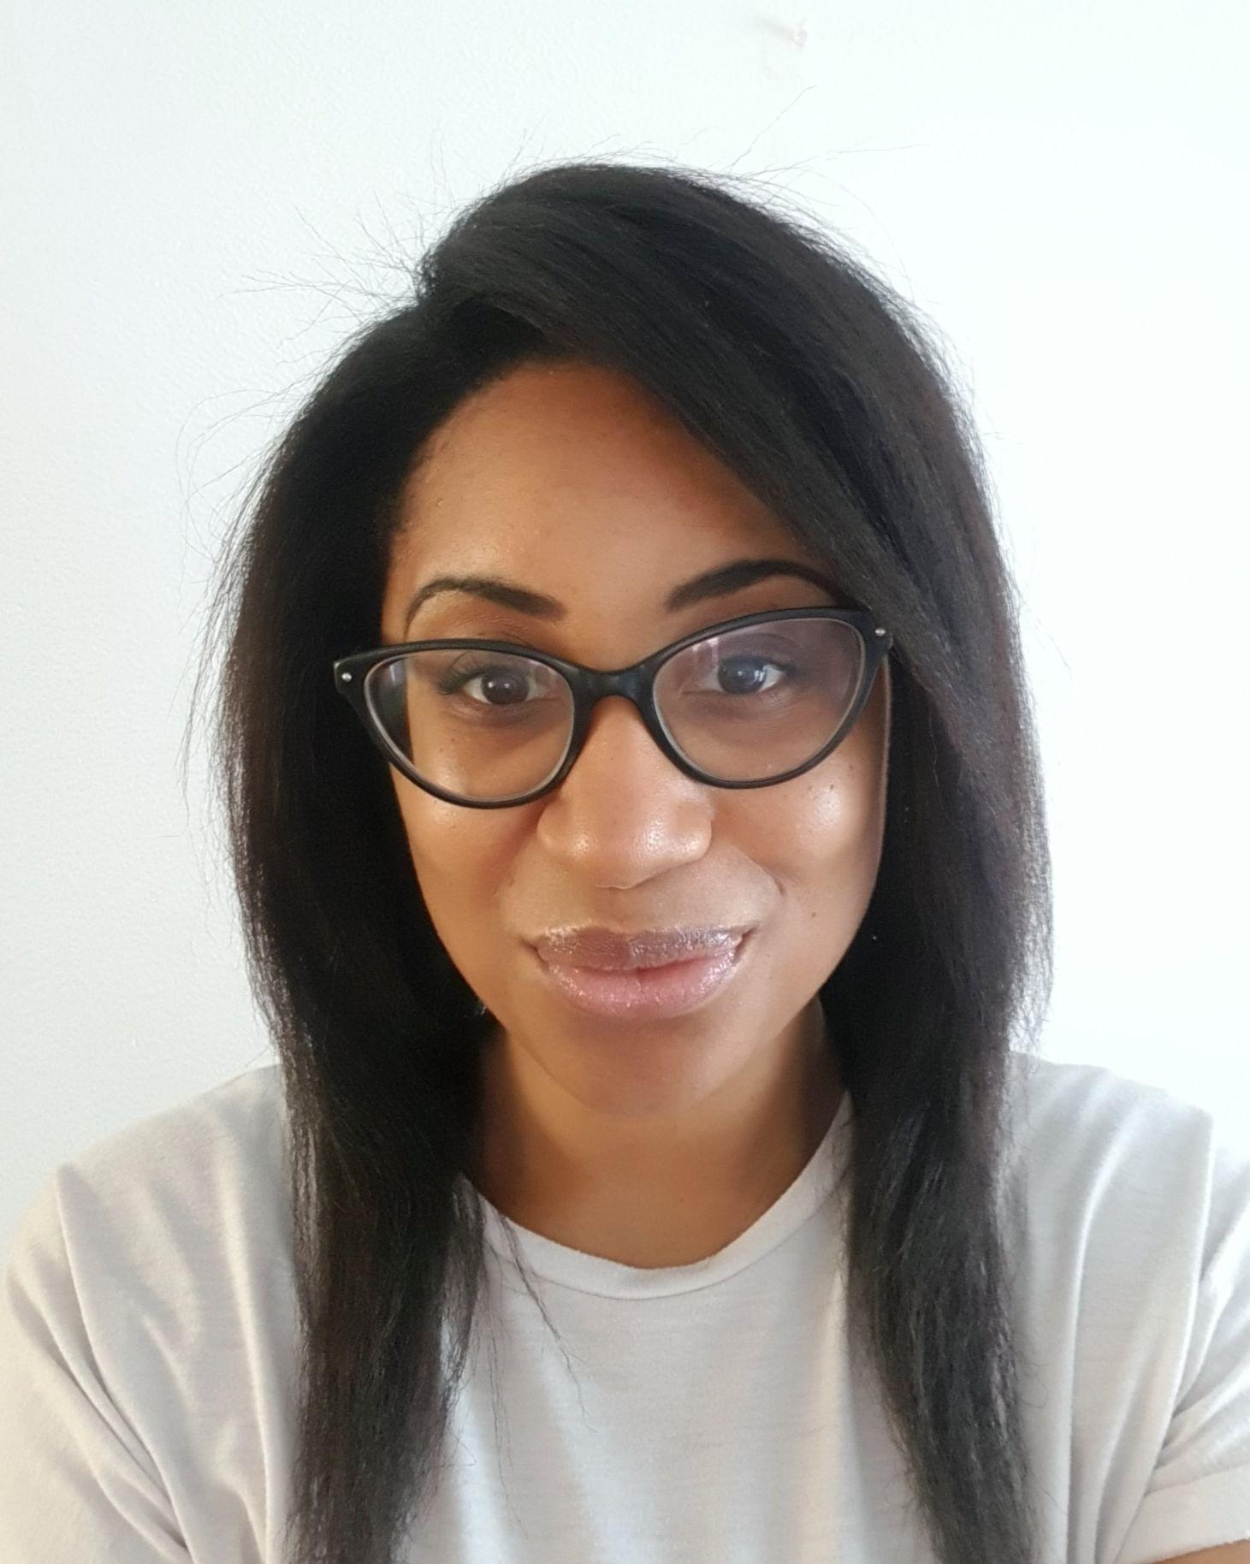
Music
Ms Ellis
Music Teacher
Teaching classroom music in the music classroom on Tuesday, Wednesday, Thursday and Friday.
Choir after school Y2 - 6; 3:15 - 4:15 (Thursdays)
  The Office will send out information about clubs.
Instrumental lessons are with:
  Berkshire Music Trust (Western classical instruments) one-on-one and small groups.
  iRock (contemporary/band instruments) in a group to form a band.
  The Office will send out information about a free taster and sign up.

Slide 7
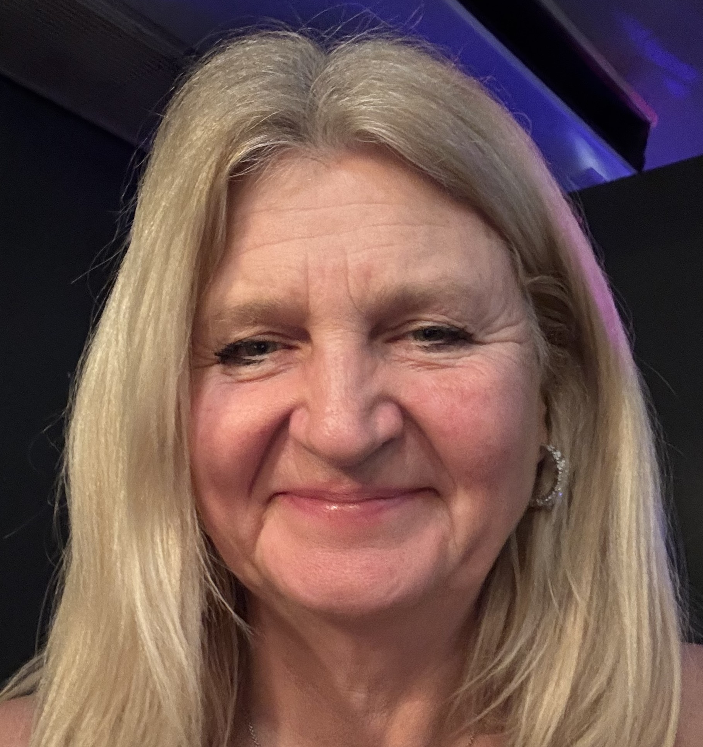
PE - Physical Education
Mrs Barnes
PE teacher - PE Subject Leader
Teaching PE all day on Tuesdays and all day on Wednesdays and Thursday afternoons
Clubs on Enrichment timetable
  The Office will send out information about clubs via email, parents are to go on Arbor and sign you up to the Club, your parent will get an email to say that you can go to the club and they then need to pay £20 online.
  Each club has a maximum amount allowed in the club, you will be notified by email if your child has managed to get a place in the club.

Slide 8
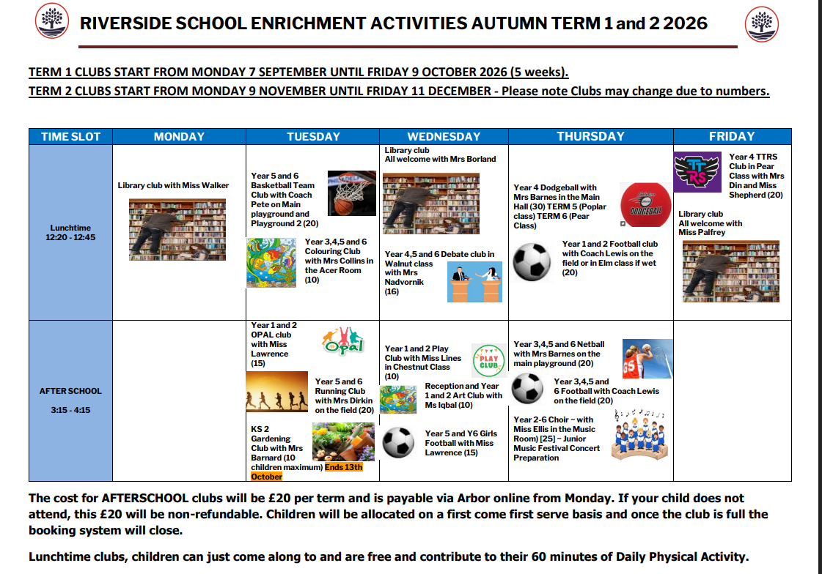

Slide 9
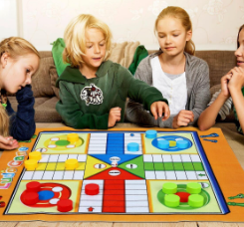

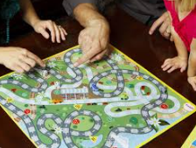
Golden time - Friday
The purpose of Golden time is to build resilience, turn-taking and emotional regulation. However, Golden time minutes will be taken away following our behaviour policy.

Slide 10




Home learning
20 minutes reading & sign reading record
4 x per week Numbots
1 lesson set by teacher per week

Slide 11
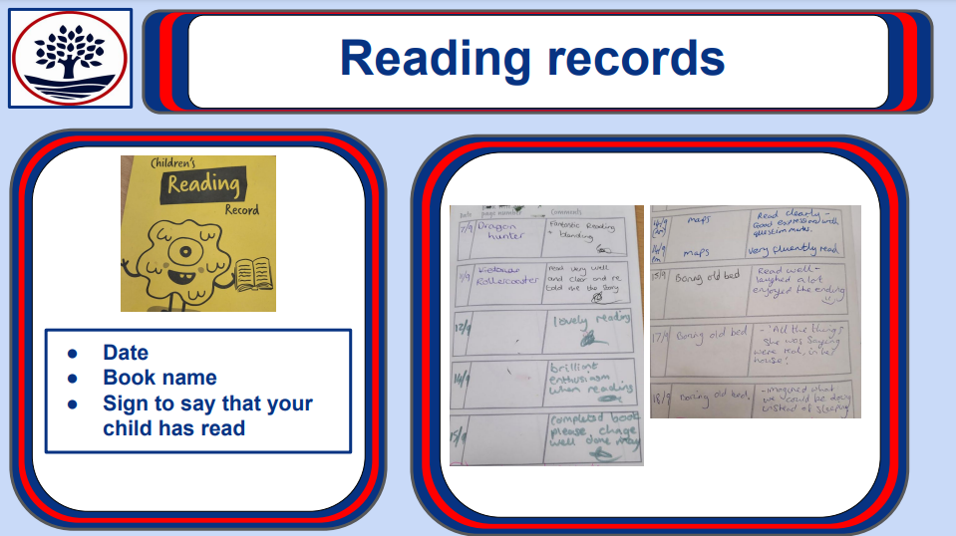

Slide 12



Parent Workshops
Spelling
RWI parent meeting
Maths
Friday 18th September
9am Hall

Slide 13


Phonics screening check
Special friends, fred talk, read the word.
Children have to read 32 words out of 40 accurately to pass.

Slide 14

Responsible Behaviour Curriculum

Slide 15

Responsible Behaviour Curriculum

Slide 16
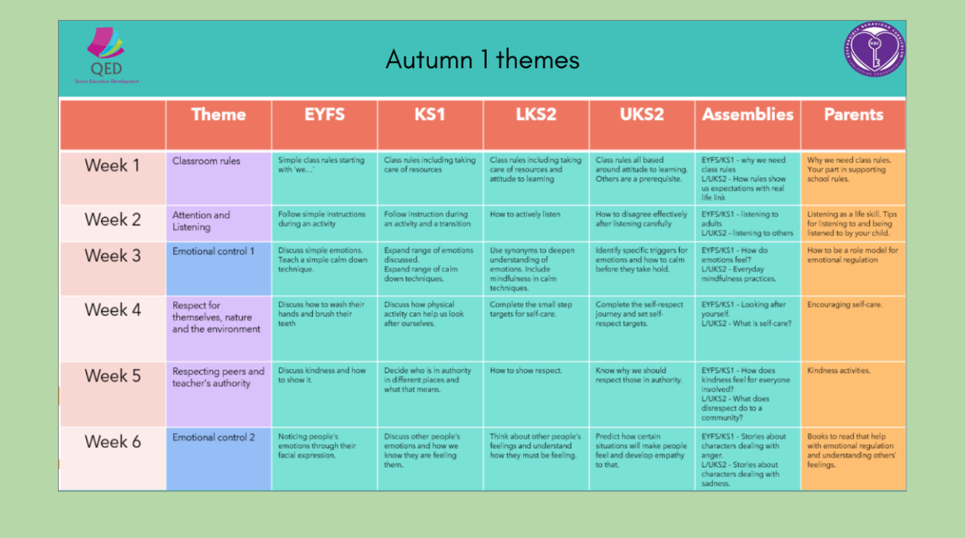
Responsible Behaviour Curriculum

Slide 17

Responsible Behaviour Curriculum

Slide 18


Slide 19
Future Dates
Monday 21st Sept 10-12 -Cherry Trip to Maidenhead Library Chestnut - 28th Sept
15th October 2:50 Harvest Singing Performance Y1
October - Halloween disco
5.10.26 - Diwali celebration
17.12.26 - Christmas fair
8.12.26 - Nativity 9.15am
19/20.1.27 - Parents evening
4.3.27 - World Book day
18.3.27 - Eid fair
June/July - Sports day
15.7.27 - Summer fair

Slide 20

Friends of Riverside
2026/2027 events:
Diwali celebration: Thursday 5th Nov
Christmas Fair: Thursday 17th Dec
Eid Fair: Thursday 18th March
Summer Fair: Thursday 15th July
Our parent teacher community needs your help. We need help to organise and run fundraising events at Riverside to raise funds for the school OPAL project.
Children of parent helpers will benefit from free vouchers to use at the events.
To sign up to help, either let your class teacher know at the end of this session or email Miss Shepherd at :
friendsofriverside@riversideprimaryschool.org.uk

Slide 21
Wraparound Care
Breakfast Club
8:00 - 8:45
£5.00 per day
Run by school staff
Ask office staff for Google Form to sign up
Held in the Dinner Hall
After-school Club
15:15 - 18:00
£15.75 per day
Run by Wraparound Care 4 U
Sign up at wraparoundcare4u.com
Held in the Dinner Hall

Slide 22


Slide 23

Any questions?

