Slide 1
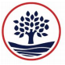
A Parent’s Guide to
Home learning
Google Classroom
Mymaths

Slide 2
What is Google Classroom?
Google Classroom is an online space for your child to learn. Teachers will set work for your child to access everyday.

Slide 3
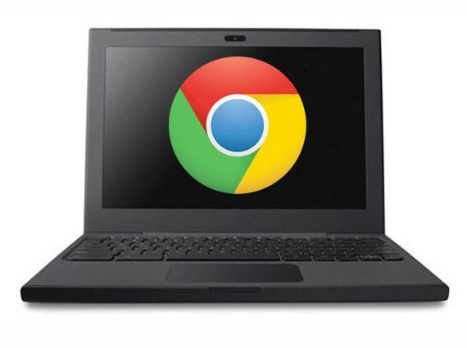
Getting started
Your child was provided with a secure log in and password that is unique to them.
Check with his/ her teacher to obtain this private information if they do not know.

Slide 4

Getting started
1. Click on the Google Chrome icon to open a browser.

Slide 5
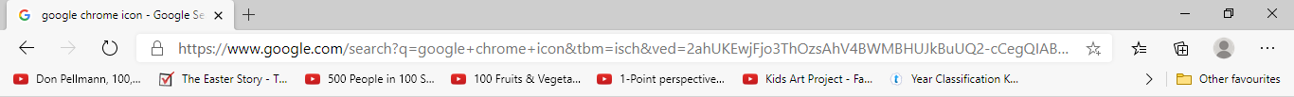
Getting started
2. Type www.google.co.uk into your web address bar.

Slide 6
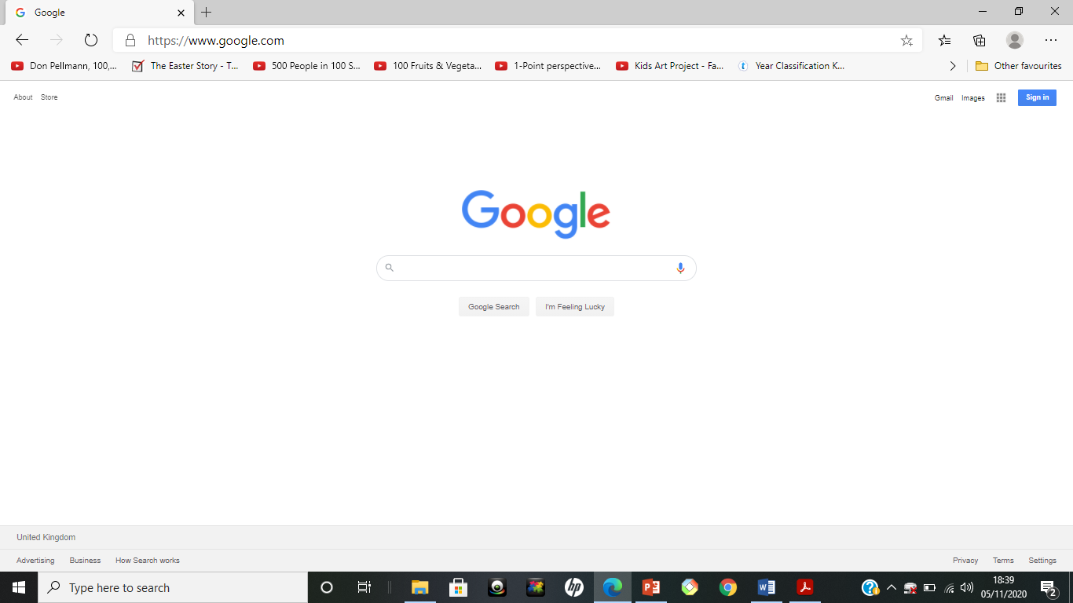
Getting started
3. Click on SIGN IN in the upper right hand corner of the web browser.

Slide 7
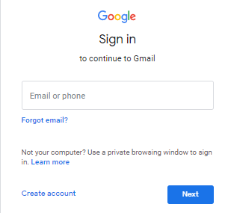
Getting started
4. Type in your child’s google email address and click next

Slide 8
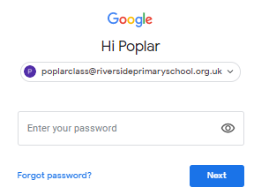
Getting started
5. Type in your child’s password and click next

Slide 9
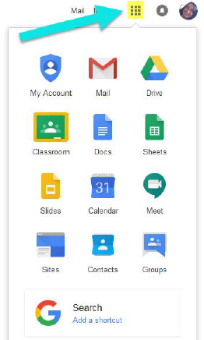
GOOGLE SUITE
6. Click on the 9 squares to view the
Google Suite

Slide 10
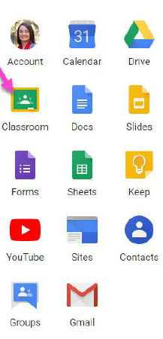
Navigating Classroom
7. Then click on the Google
Classroom icon

Slide 11
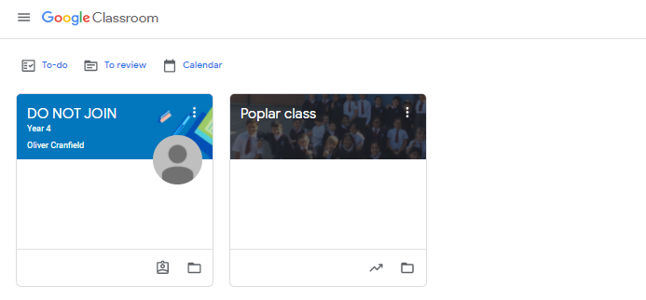
Navigating Classroom
8. Click on the class you wish to view.

Slide 12
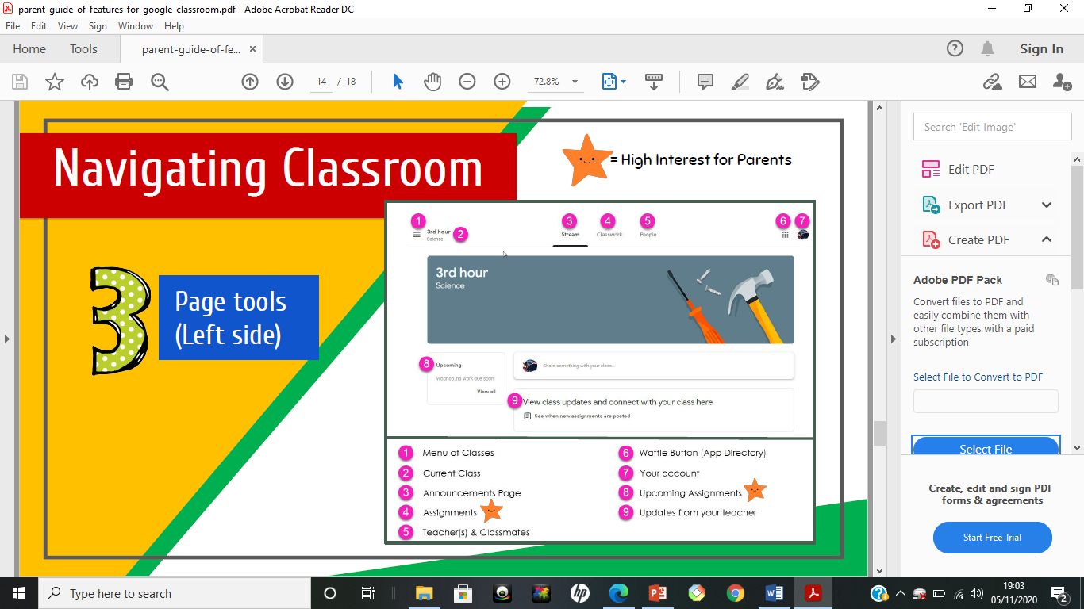
Navigating Classroom
9. Page tools

Slide 13
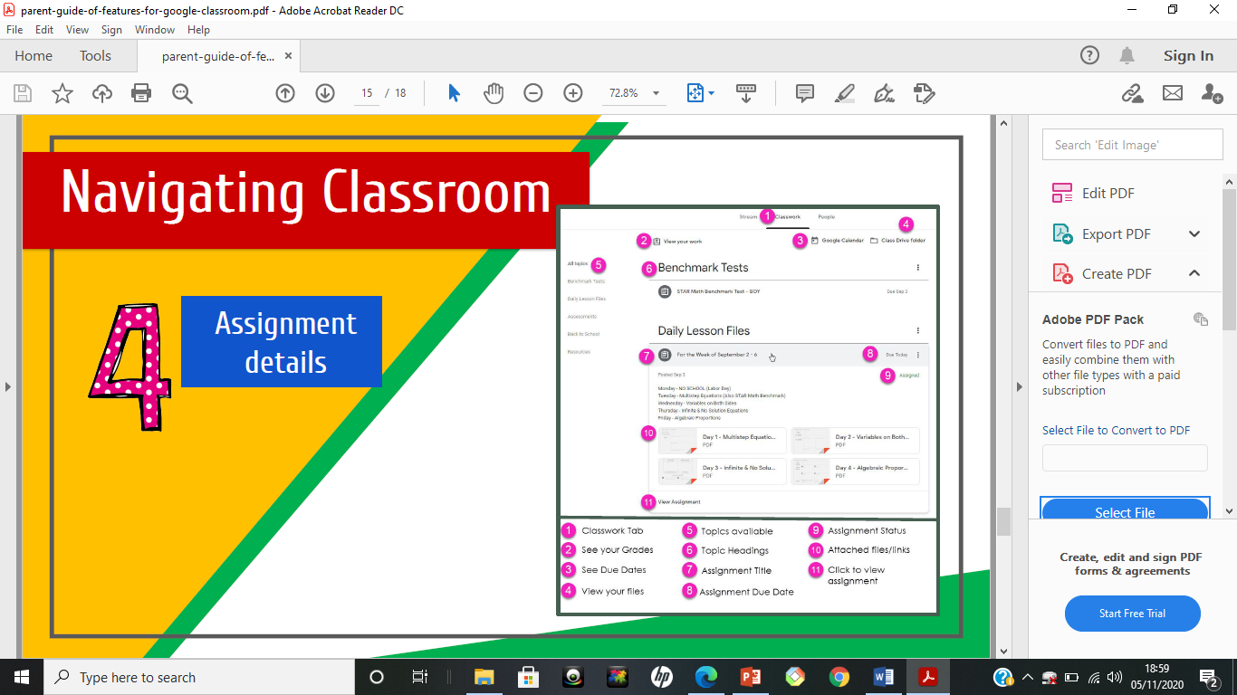
Navigating Classroom
10. Assignment details

Slide 14
What is Mymaths?
Mymaths is an online program which has a lesson for children to work through and work for children to complete. They work is marked instantly so they can see how they have done.

Slide 15
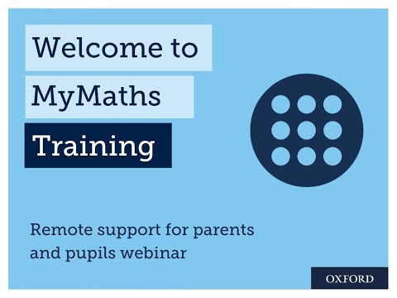
Navigating Mymaths
Watch this walk through video to understand how to help your child complete their mymaths learning.
Your child has been sent a letter with their mymaths login details on. If you cannot find this, please email your teacher using the class email.

Slide 16
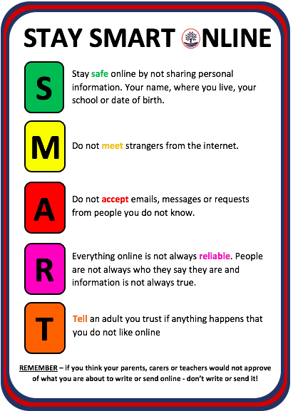
Stay safe online
Your child can also explore and play games to help them learn more about how to stay safe online on the website below.
Google Internet Legends
https://beinternetlegends.withgoogle.com/en_uk/interland
Please remember to go through how to stay safe online with your child using our SMART tips seen here.

